Slide 1
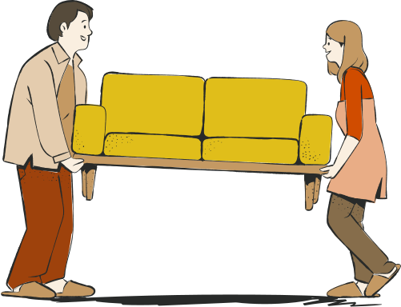
Thriftn’
Presented By:
Aiman Zahoor
Zainab Usama

Slide 2

The Problem
Economic challenges
Excessive waste generation
Deceptive pricing
Underutilizing items

Slide 3


Definition
Thrift store is a place for buying & selling old items.
Items are sold at lower price than their original retail value

Slide 4
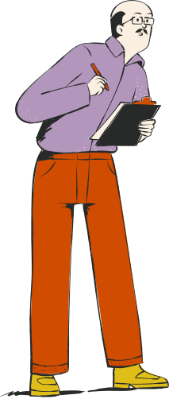
The current setup
Limited audience reach
Crowded platforms( stores on facebook,instagram)
Lack trusted sellers
Limited quality assurance
Scam risks
No direct sales

Slide 5

Research
& Review
Minimalist trend
Cultural tradition of sharing & giving
Post-COVID sales boost
Cost-saving
Environmental concerns
]https://ijcrt.org/papers/IJCRT2208238.pdf

Slide 6
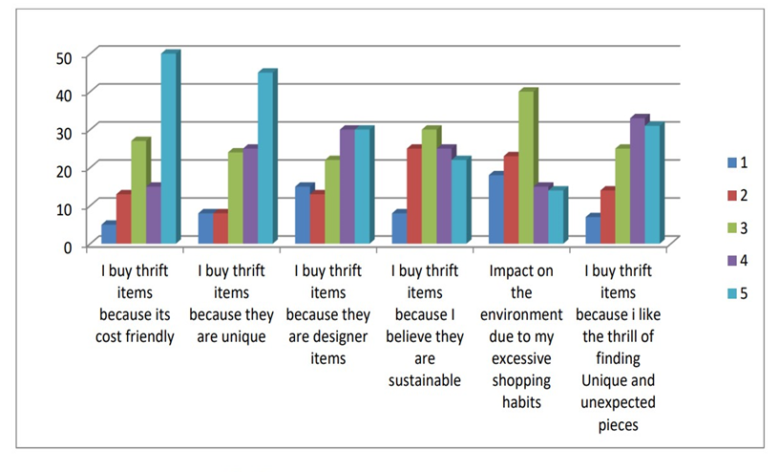
According to a study below are some factors that encourage the use of thrift stores
https://ijcrt.org/papers/IJCRT2208238.pdf

Slide 7


eBay
Big online market and trust
Auction styles
limitations on number of listings
Greater priority to top-rated items

Slide 8

The Fix
Goal :
creating a web application that allows people to buy and sell affordable second-hand items or donate items.

Slide 9
The Fix
helping those struggling with inflation and contribute to reducing waste
evolution of sharing tradition and
promoting social good

Slide 10
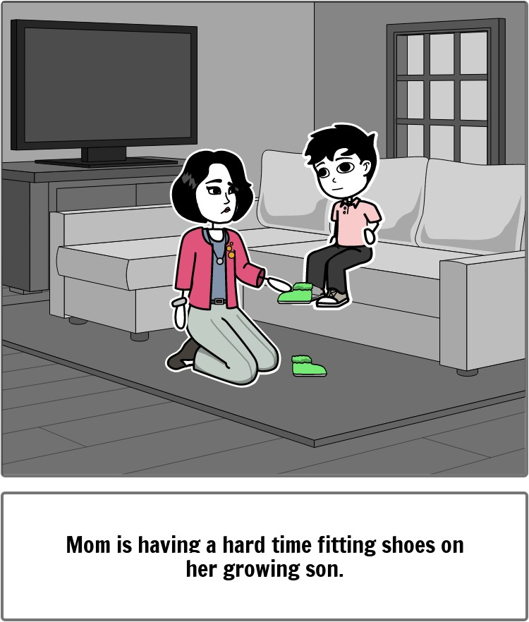
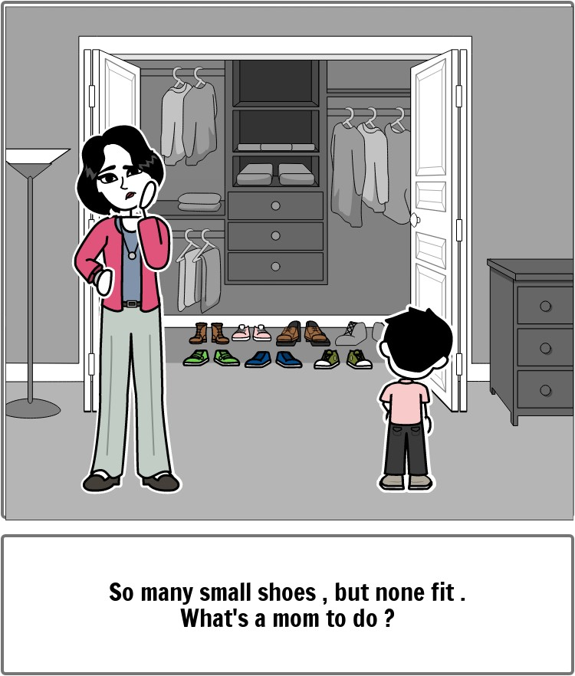

Slide 11
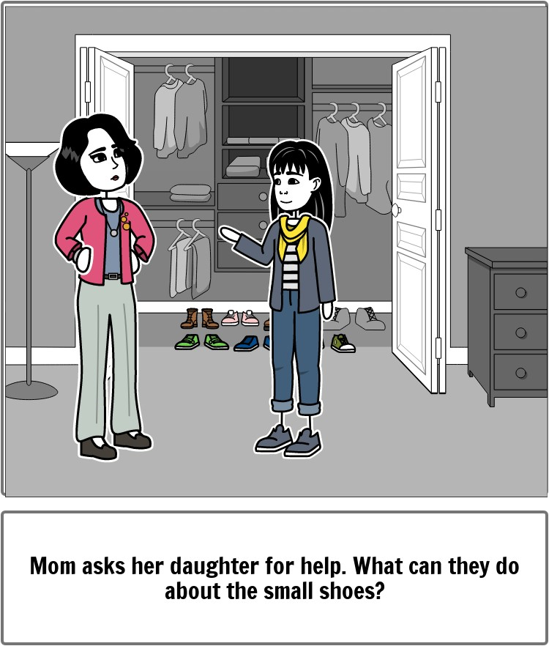
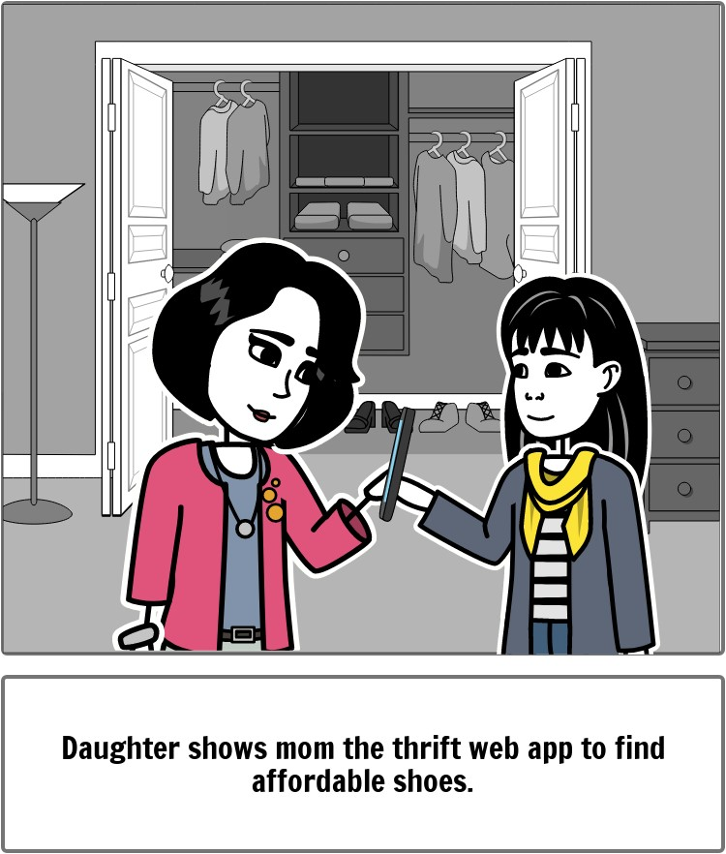

Slide 12
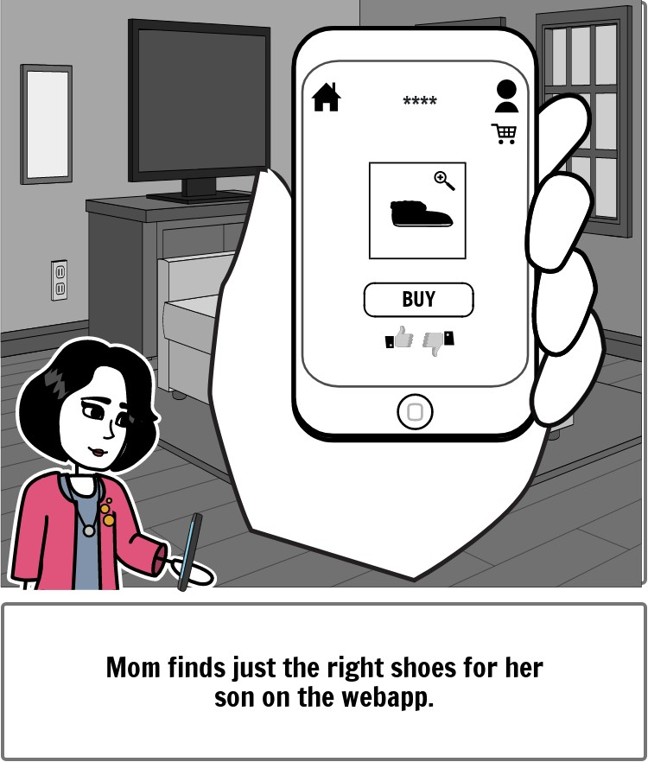
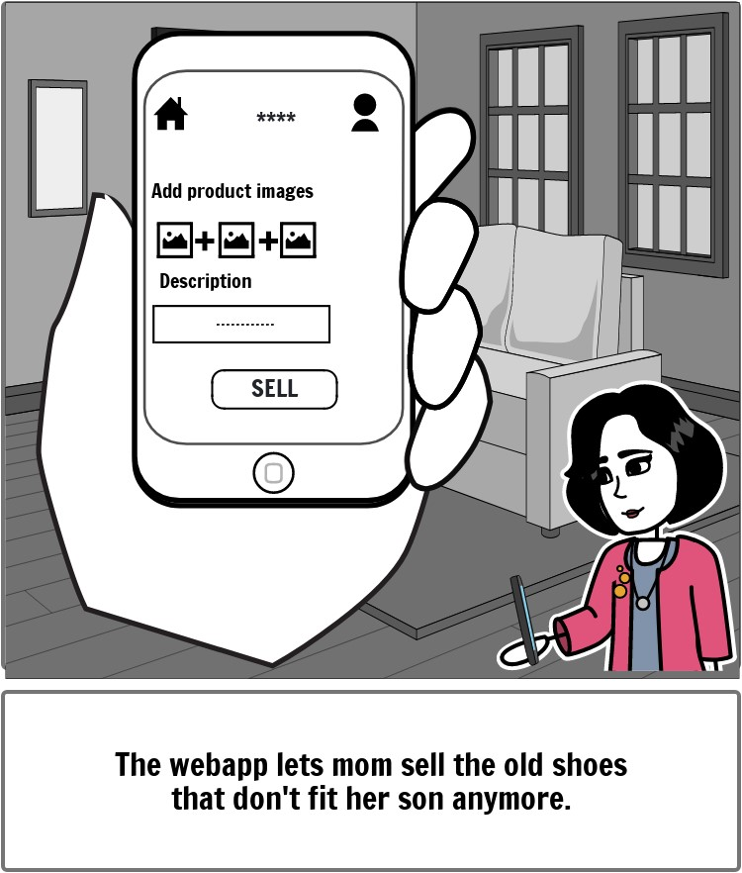

Slide 13
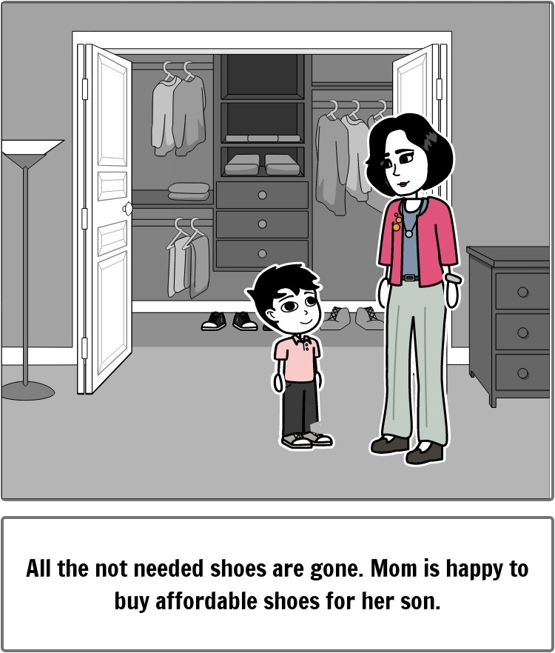

Slide 14
The Fix
Quality control:
offering video uploads by sellers to make sure buyers are able to asses’ items properly.
Enhanced user experience:
dedicated section for newly added items, supporting emerging sellers.
assigning ‘Trusted-Seller’ badges based on reviews and ratings by the buyers.

Slide 15
Flexibility:
recommendation system
Price negotiation.
Accessibility & Support:
24/7 chatbot for continuous assistance.
Adjustable text-sizes and text-to-speech capabilities.
The Fix

Slide 16
The Fix
Safer environment:
utilizing SocialSense AI to filter out comments or reviews that are abusive and harmful.
providing authentication , only buyer can review or rate the item.

Slide 17

Business model
Buying
Selling
Delivery fee
5% platform fee
Delivery
Payment
collaboration
COD & online payment
Donating
collaboration

Slide 18
Cost for development :
Inventory
Delivery collaboration
Marketing
Unforseen expenses

Slide 19

Technologies
back-end
front-end
SpringBoot/Java/
Python
Reactjs./Html CSS
Database
Development Process
Mysql
GitHub

Slide 20
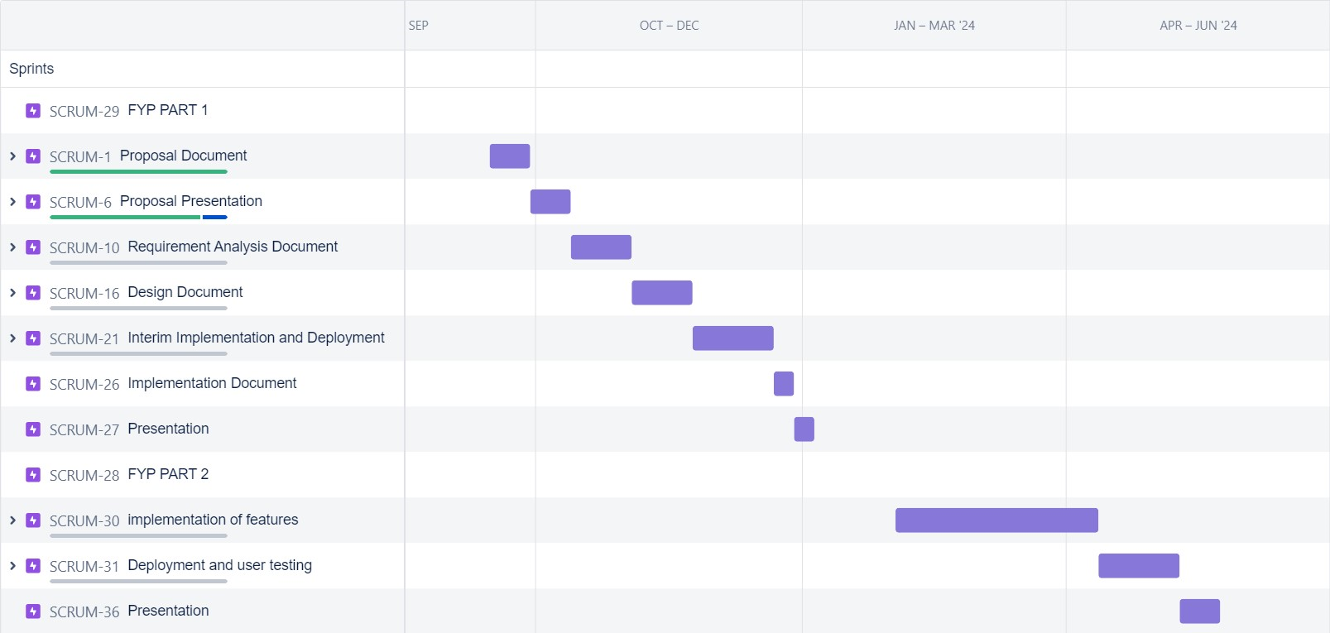
Timeline

Slide 21

Deliverables
A responsive web app that allows users to sell, buy and donate pre-used items with ease.
Provides flexibility , Safety , availability & accessibility

Slide 22

Muhammad Danyal
Expertise
An expert who will be helping us out with technical issues and figuring things out.
worked as a full stack senior engineer at Zalando SE
worked as a core member of Java/Spring Backend at VentureDrive

Slide 23
Prototypes

Slide 24
Thank you

